Slide 1

INT 300 INTERNSHIP II : FINAL REVIEW
Date : 31-MARCH-2022
Streamlining ML pipelines for clinical workflow in risk factor analysis for cardiovascular disease (CVD)
Project Mentor | Presented By
G. Jayanthi Ph. D., jayanthig@sret.edu.in | Joselyn Diana Cindrella M – E0120017
Prof. N. Chiranjeevi, chiranjeevi@sret.edu.in
31 March 2022
INT 300 Internship II : Final Review
‹#›

Slide 2
AGENDA
Introduction
Review of Literature/Product
Problem Statement
Objective
Methodology
Progress of Work
Future Work
References
31 March 2022
INT 300 Internship II : Final Review
‹#›

Slide 3
INTRODUCTION
Motivation :
To create an awareness among people about the social and biological risk factors that cause cardiovascular disease.
Existing Approaches and Need for further study
The present approaches are done using Deep learning and not machine learning algorithms.
Applications & Technologies:
We can use computer aided machines to improve the medical diagnosis which can be developed using the Python programming and we can visualize the data using Tableau and which can also be displayed on storyboard.
31 March 2022
INT 300 Internship II : Final Review
‹#›

Slide 4
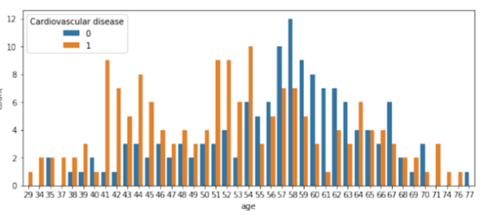
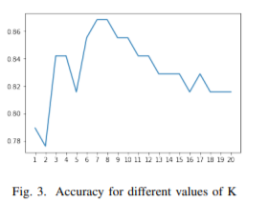
REVIEW OF LITERATURE/PRODUCT
Author: Muhammad Anwarul Azim,Md Rayhan Kabir,Rasif Ajwad Title: Identifying the Risk of Cardiovascular Diseases From the Analysis of Physiological Attributes
Methodology : Analyze the dataset, preprocessed the data using various supervised machine learning algorithms.
Results : Accuracy using KNN and Decision Tree is 86.84 and 78.95 respectively.
Limitation : Need of the usage of deep learning algorithms for better accuracy.
Challenges : Extracting data regarding the ECG patterns and formats.
Statistics : Chart
31 March 2022
INT 300 Internship II : Final Review
‹#›

Slide 5
PROBLEM STATEMENT
Description:
To analyze cardiovascular dataset using Python and Tableau with ML pipeline algorithms to find the risk factors causing heart disease.
OBJECTIVE | METHODOLOGY
1. To collect the data samples | 1. Dataset - Kaggle
2. To pre-process the dataset and prepare for ML task | 2. Python
3. To visualize the data | 3. Tableau
4. To create ML model | 4. Python
5. To display all the work | 5. Website, Streamlit
31 March 2022
INT 300 Internship II : Final Review
‹#›

Slide 6
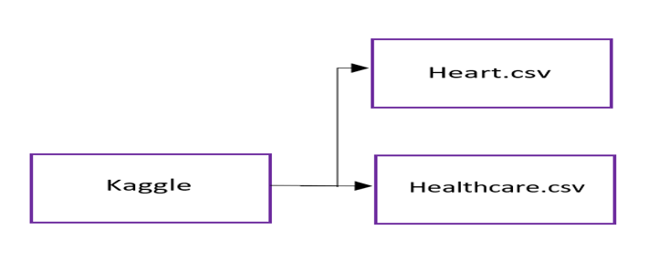
METHODOLOGY - 1
Description:
Collecting the data for the social and biological factors causing heart disease,
Collecting the patients data along with their medical records.
Workflow Diagram:
7 February 2022
INT 300 Internship II : First Review
‹#›

Slide 7
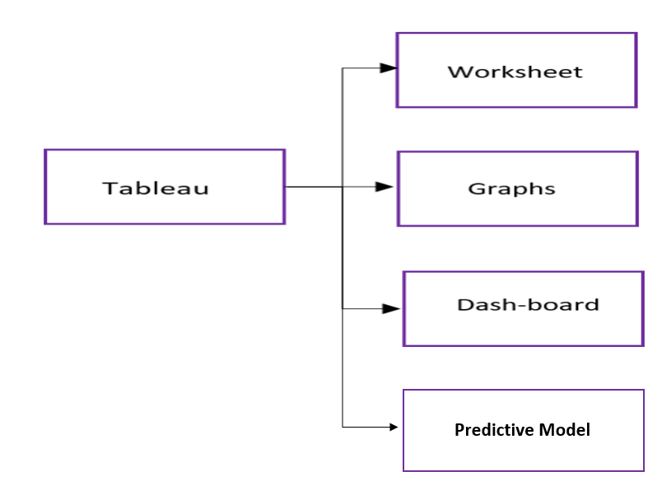
METHODOLOGY - 3
Description:
Visualizing the data using measures and dimensions using Tableau.
Creating dash-boards / story-boards.
Workflow Diagram:
31 March 2022
INT 300 Internship II : Final Review
‹#›

Slide 8
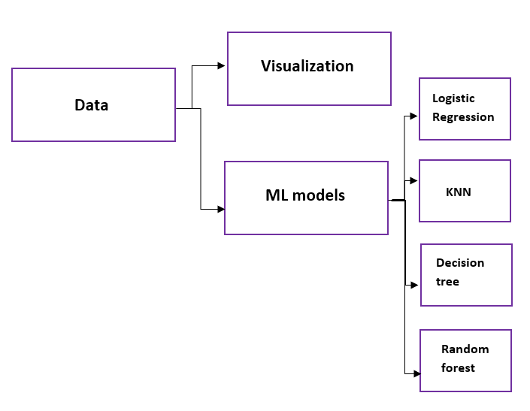
METHODOLOGY – 2 and 4
Description:
Visualization using python.
Creating ML models to predict accuracy.
Workflow Diagram:
31 March 2022
INT 300 Internship II : Final Review
‹#›

Slide 9
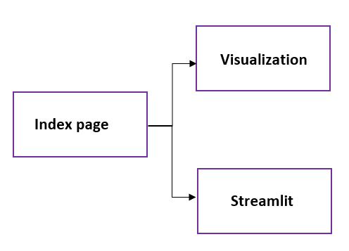
METHODOLOGY – 5
Description:
Webpage.
Workflow Diagram:
31 March 2022
INT 300 Internship II : Final Review
‹#›

Slide 10
PROJECT WORK REPOSITORY
GitHub Repository Link: https://github.com/2022-SRET-INT300/Cardiovascular-Disease
Tableau Public Link: https://public.tableau.com/app/profile/joselyn.diana.cindrella#!/
31 March 2022
INT 300 Internship II : Final Review
‹#›

Slide 11
FUTURE WORK
Cohort analysis using the collected data
Prediction using Machine Learning
31 March 2022
INT 300 Internship II : Final Review
‹#›

Slide 12
REFERENCE
https://www.kaggle.com/fedesoriano/heart-failure-prediction
https://www.kaggle.com/praagnya/heart-disease-prediction
https://visualbi.com/blogs/tableau/tableau-integration-r/
https://sci-hub.hkvisa.net/10.1109/TENSYMP50017.2020.9230887
https://www.analyticsvidhya.com/blog/2020/12/integrate-r-tableau-and-excel/
31 March 2022
INT 300 Internship II : Final Review
‹#›

Slide 13
THANK YOU
31 March 2022
INT 300 Internship II : Final Review
‹#›

